Slide 1
Match HeDFT and neutral dynamics

Slide 2
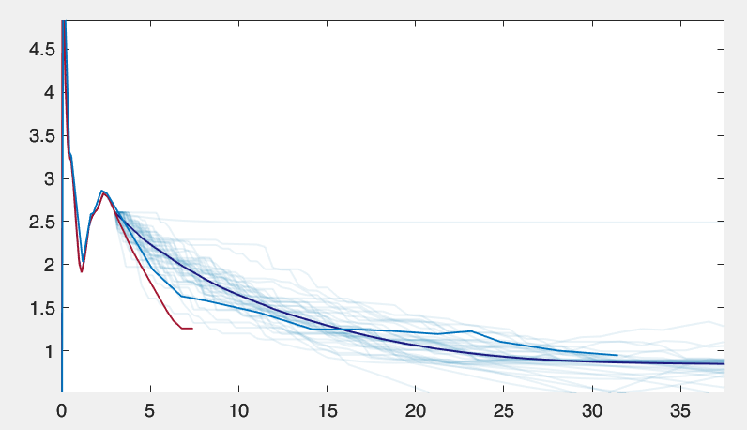
Sigma0 = 60 Angström^2
Emin corresponds to 100 m/s limit velocity

Slide 3
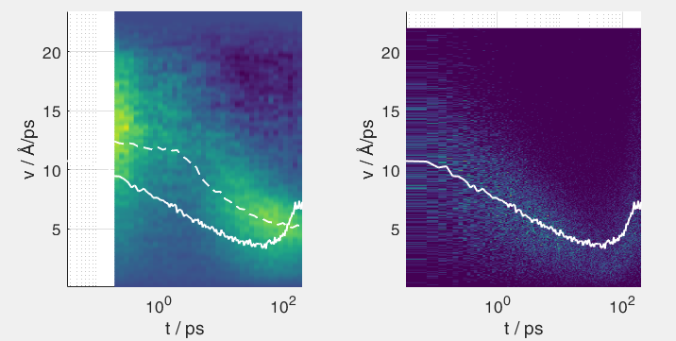
Ion dynamics
Sigma0 = 10 Angström ^2
Two he charges
Highly charge iodine

Slide 4
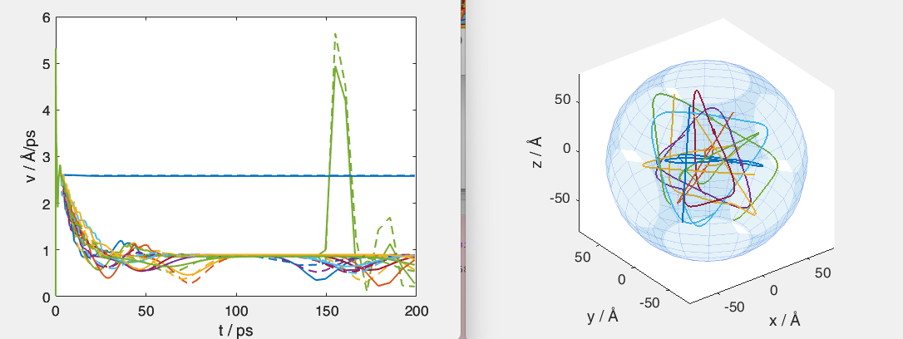
Neutral traces

Slide 5
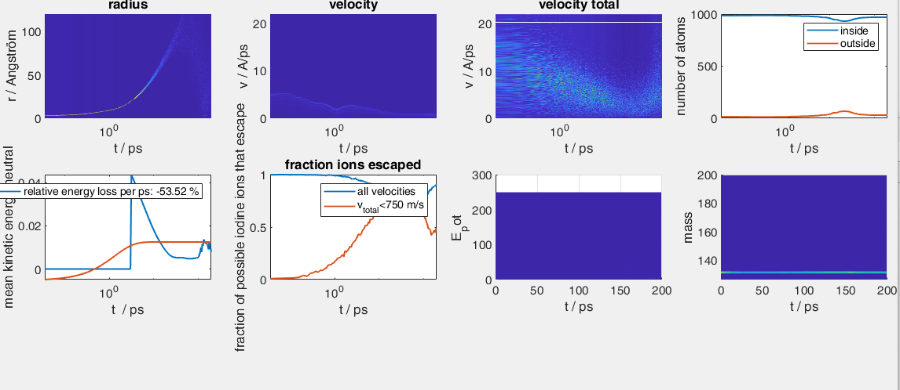

Slide 6
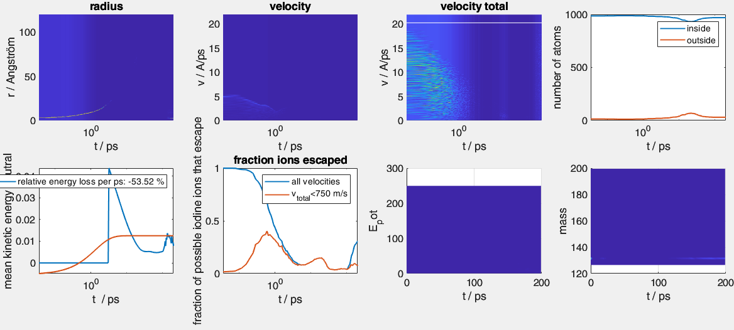
Test sigma const for ions (sigma0 1900 Angström^2)
I+He ion do not make it out of the droplet here (no extra He ions, no extra charges)

Slide 7
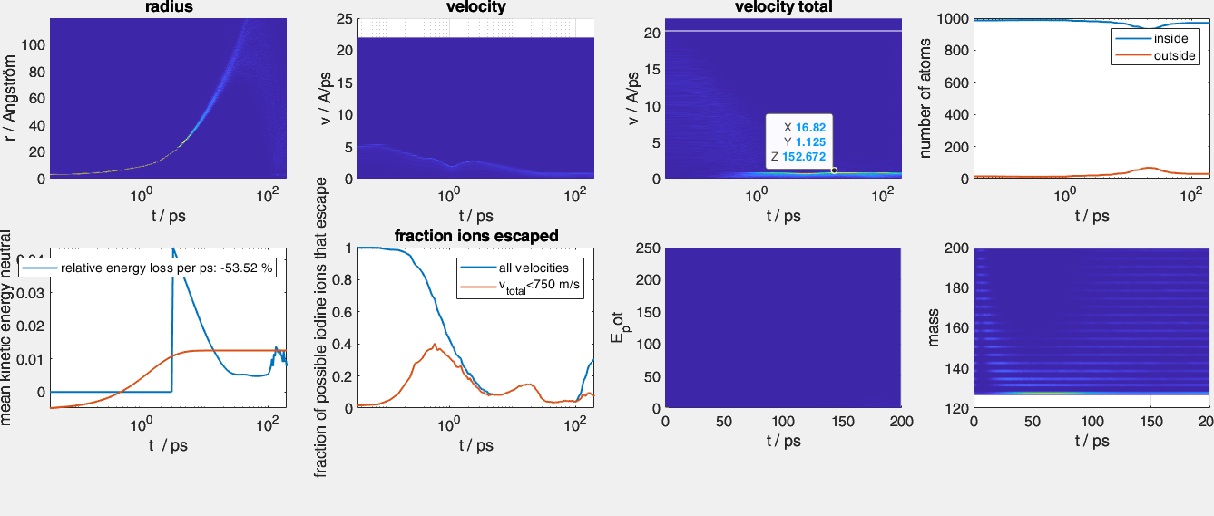
Check what final ion velocities would be
Only capture of neutrals close to 9 Angström could explain the final ion velocities
➔ Interatomic distance is much larger than 9 Angström for all ions this is caused by mimicing the HeDFT neutral dynamics

Slide 8
Test
Stop mimicking HeDFT before the interatomic distance is equal to 9 Angström
Introduce a dimple in the X potential with depth of 35 meV
This should be able to capture I atoms moving at 210 m/s (which they do at about 0.8 ps of the HeDFT neutral sim.)
127 u * (210 m/s)^2/ 2
What is the physical meaning of this? ➔ collision of I atoms with He density leads to crossing to X- state why should there be a decrease of ion velocities over time? Sinking of recombined molecule back into the droplet!

Slide 9
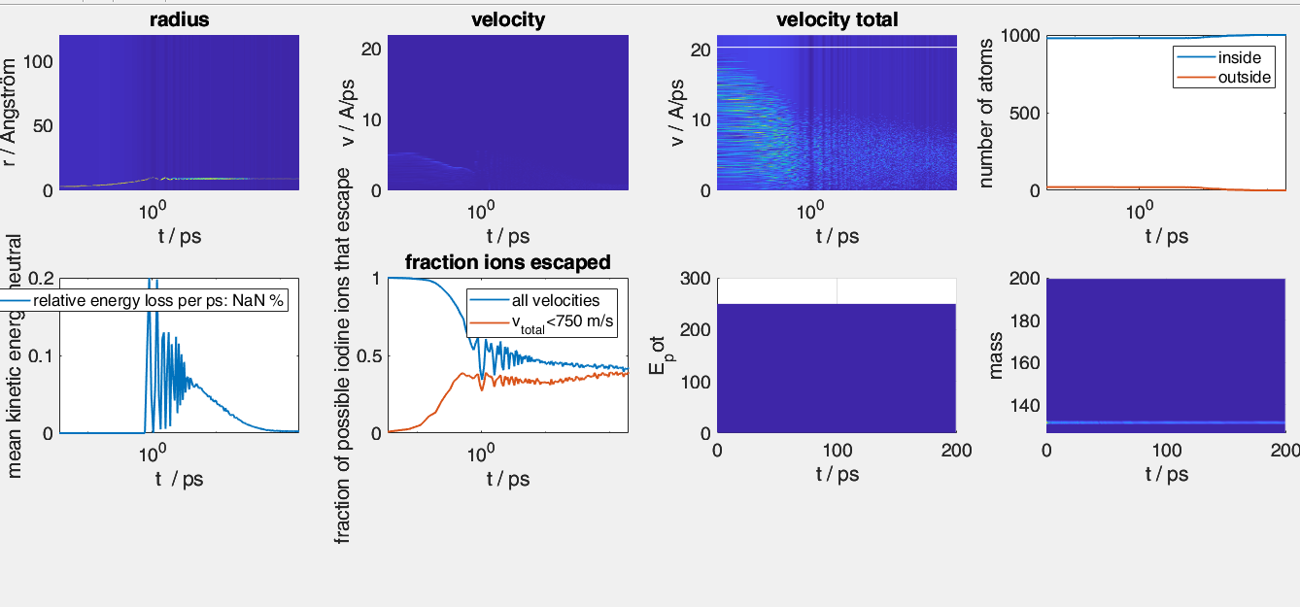
Kinda works

Slide 10
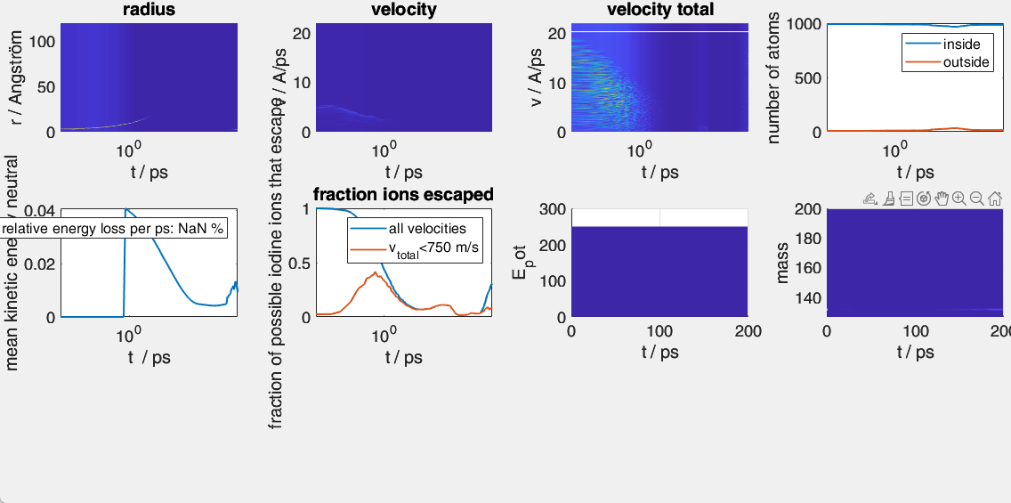
Sigma(v), sigma0 = 1900

Slide 11
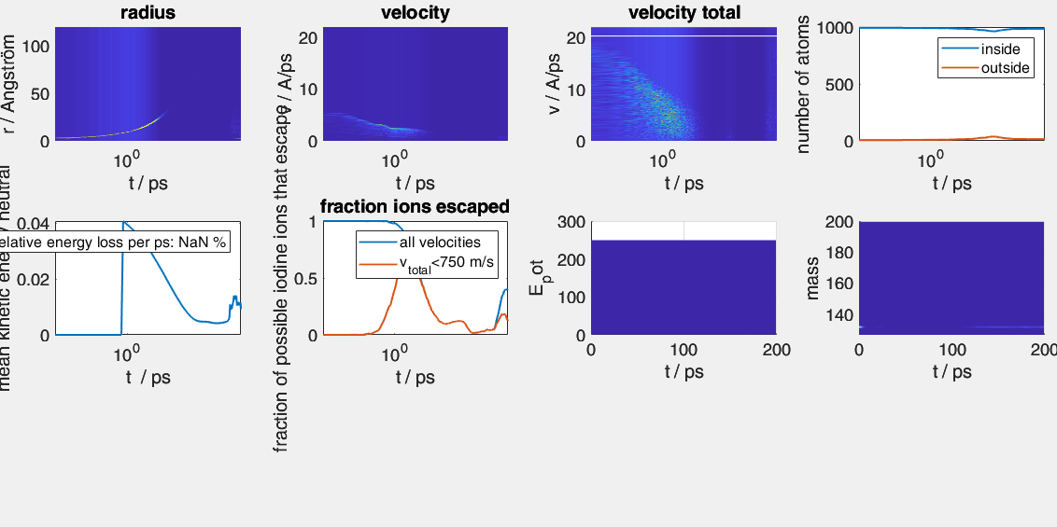
Sigma(v), sigma0 = 800
I+He ions do not show up

Slide 12
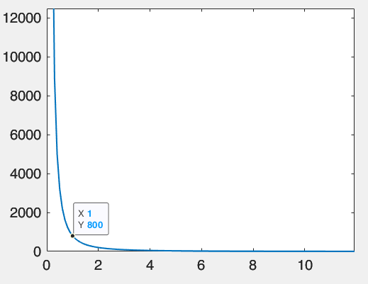
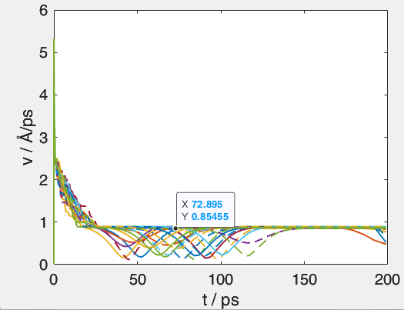
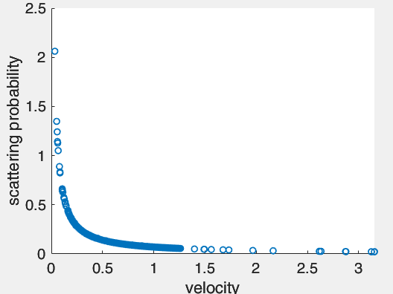
Problem: initial velocity of ions
If v0 is too low, so that crosssection is extremely large at the initial velocity, ions will stay trapped, because an extrem number of collisions will occur
So far, ions have zero initial kinetic energy, except the kinetic energy of the neutrals
Sigma0 = 800
Sigma(v) = sigma0 v^-2
Since landau velocity is 0.9 A/ps the initial crosssection is

Slide 13
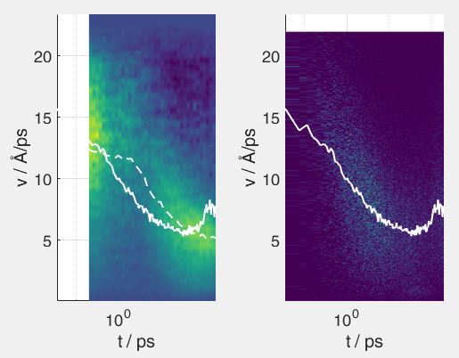
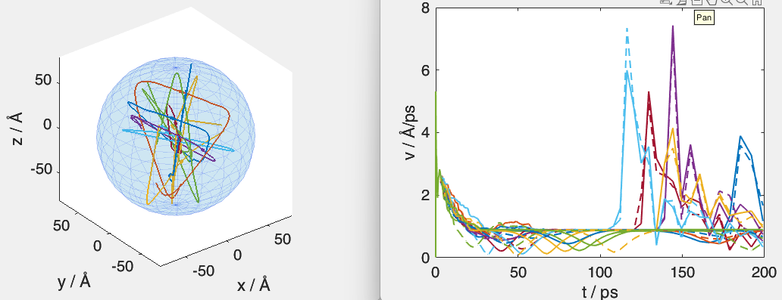
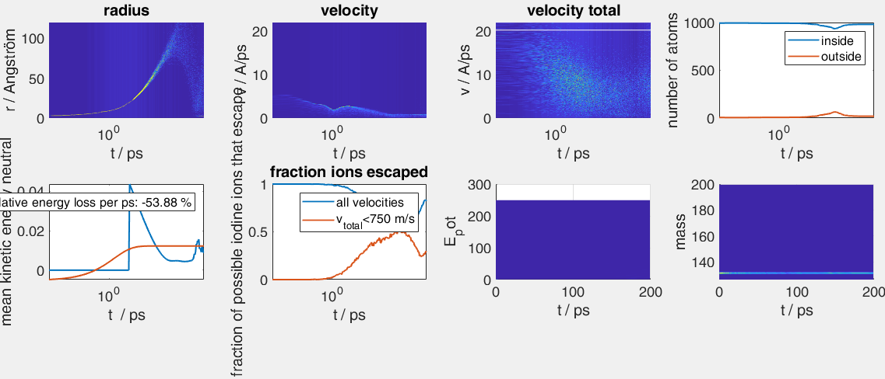
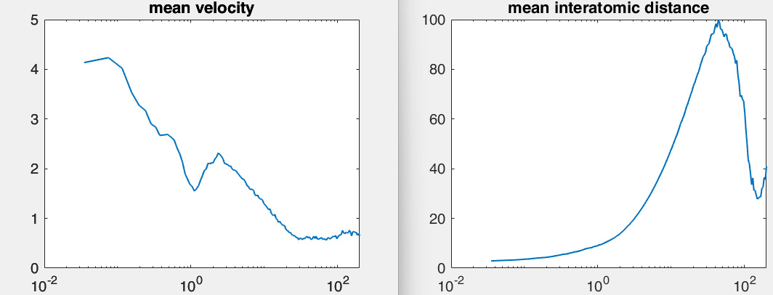
Run simulation with additional he charges (3) and high charge I2^3+

